Slide 1

INFORMATION TECH CONSULTANTS
Movie Rental Analysis
By
Isaiah, Buvana & Devi

Slide 2
INTRODUCTION
Our project aims to analyse movie rental data to provide insights into customer preferences on the movies and improve the inventory and area sales. The data was collected from a Movie rental company and includes information on movie titles, customers, rentals, inventory, store and payment.
The problem we are addressing is that the company wants to improve the inventory and increase revenue by providing better movie recommendations. By analysing the rental data, we hope to identify the most popular movie genres, the most successful marketing campaigns, and the most effective pricing strategies.
Our objective is to identify patterns and trends in the data that can be used to improve the company's movie recommendation system, for inventory and customer sales by area. By understanding customer preferences, we can help the company optimize their inventory, store, and marketing strategies.
The technologies and tools we used in this project include MySQL for scripting, Hadoop Distributed File System (HDFS) for storing the data, Apache Scala Spark for data processing, Hadoop HDFS for Ingestion and Hive & HBase for showing the Output. We also used Apache Superset for data visualisation.

Slide 3
Project Overview
Movie Rental Analysis
The data source is in MySQL.
Used Scala Spark to Ingest data into HDFS.
Analysed and transformed the required tables into Hive
Used Scala Spark to provide the JDBC database connection for transformation.
Converted the Scala class into .jar file
Loaded the result into hive table.
Produced the output in HBase as well.
Created Visualisation charts in Superset to display the results.
Information Tech Consultants

Slide 4
inventory
Inventory_id (PK)
Film_id
Store_id
Last_update
Payment
Payment_id (PK)
Customer_id
Staff_id
Rental_id
amount
Payment_date
Last_update
Rental (Fact Table)
Rental_id (PK)
Rental_date
Inventory_id
Customer_id
Return_date
Staff_id
Last_update
film
Film_id (PK)
title
description
Release_year
Language_id
Rental_duration
Rental_rate
length
Replacement_cost
rating
Last_update
Special_features
fulltext
customer
Customer_id (PK)
Store_id
First_name
Last_name
Address_id
address
Address_id (PK)
address
district
City_id
phone
store
Store_id (PK)
Manager_staff_id
Address_id
Last_update

Slide 5







Project Architecture/Pipeline
Cleaning/Analysing /Processing
Curated Output
Ingestion
Visualisation

Slide 6
Project Workflow
Cleaning/Analyse and processing
Start
Datasource
Scala Spark
Loaded to Hive
Ingesting data into HDFS
Scala Spark
Final curated output in HBase
Visualisation
END

Slide 7
Use case
Our Use case was to analyse the Movie rental dataset of a company to find out which movies are rented on a higher rate and how much income did they bring to the company. Using this information, we also found out how many movies are rented and not rented to decide on the Inventory.
Inventory was analysed to make sure that the non rented movies can be sold and replaced by new more preferred movies to increase those stocks.
We also analysed the 2 stores of the company which was renting the movies to find out which store makes more business so that, we can either bring the stock from the non popular store to the popular store.
Another analysis was also done to establish, customer in which areas are taking the movies on rental frequently so that using the store information, we can open a new store in the demanding area/district.
This analysis was done on the dataset to improve the companies business in various ways. We will see in more detail later during the presentation.

Slide 8
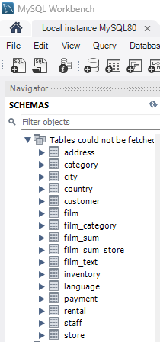
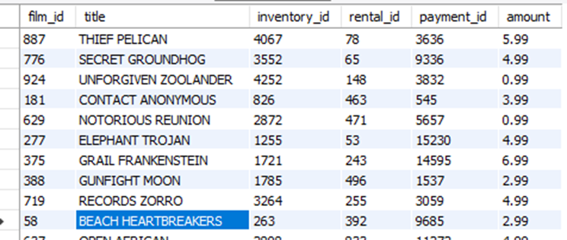
Data Processing
Data Source: DB in MySQL

Slide 9
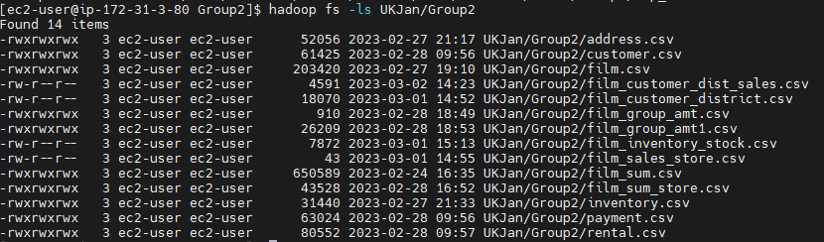
Data Processing
Ingestion into Data Lake: From MySQL to Scala-Spark to HDFS

Slide 10
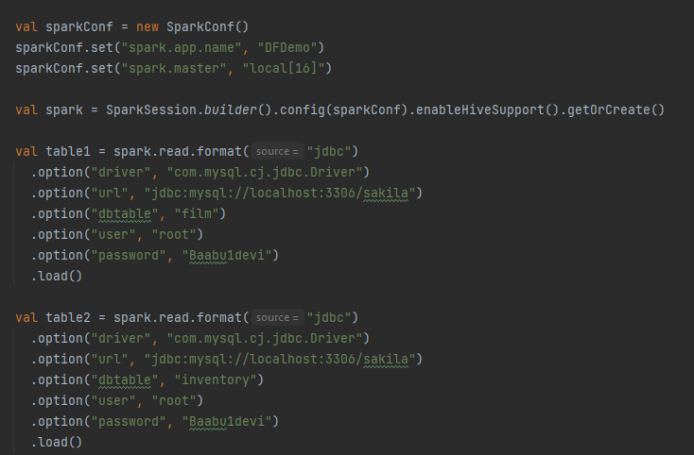
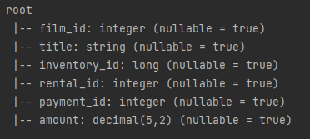
Data Processing
Data Cleaning: Checked for duplicate entries, missing values, data types and inconsistent data.

Slide 11
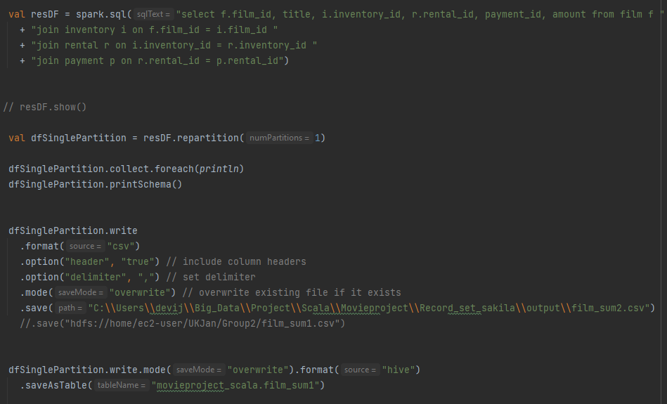
Data Processing
Data Transformation: Used Scala Spark to do the transformation, converted to Jar file and saved in Hive

Slide 12
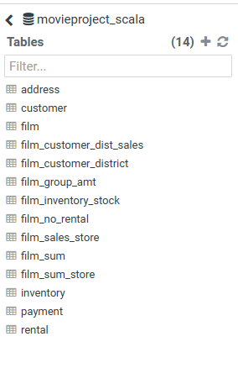
Data Processing
Data Warehouse using Hive:

Slide 13
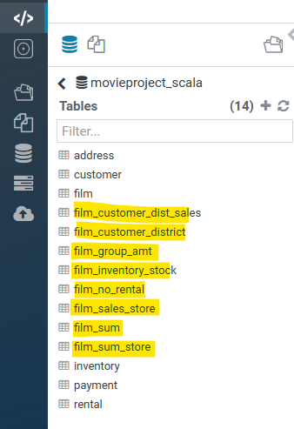
Code snippet and sample output
Using the transformation we came up with 7 new tables to conclude our use case.
The main tables and the output in Hive and HBase are as below. The tables in yellow are our transformed tables from the raw data in Hive.

Slide 14
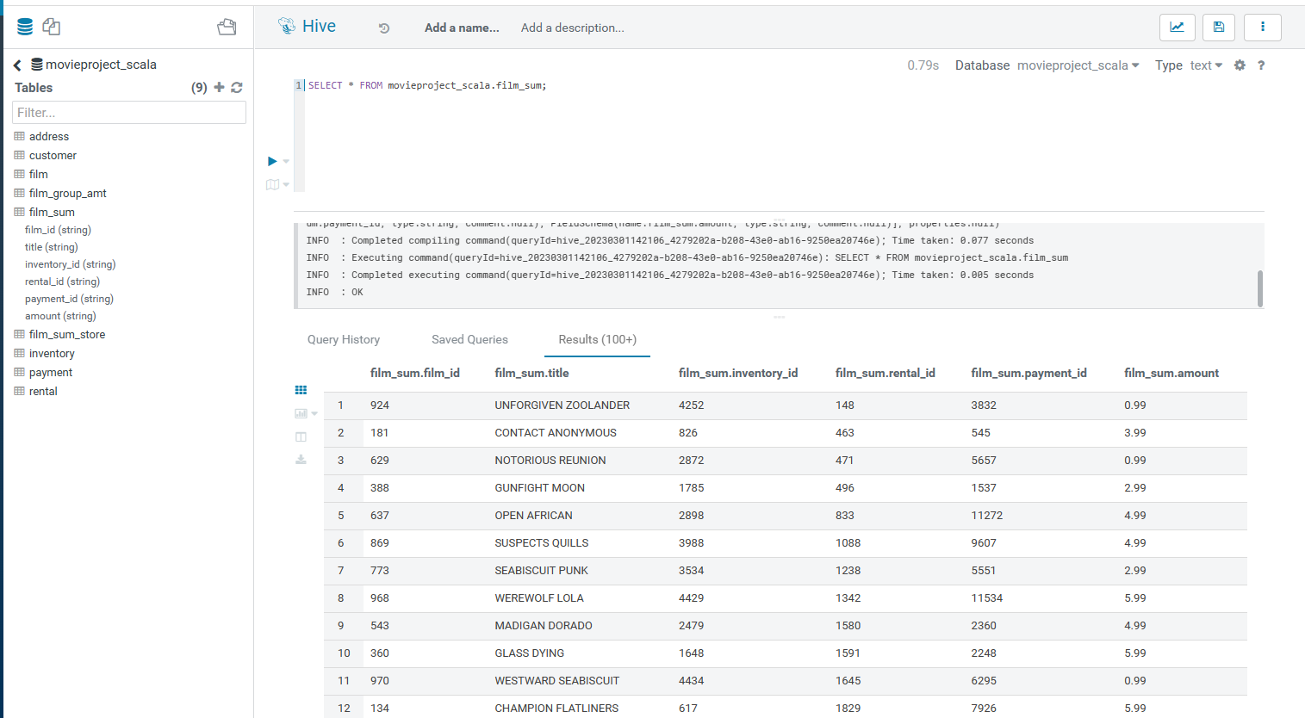
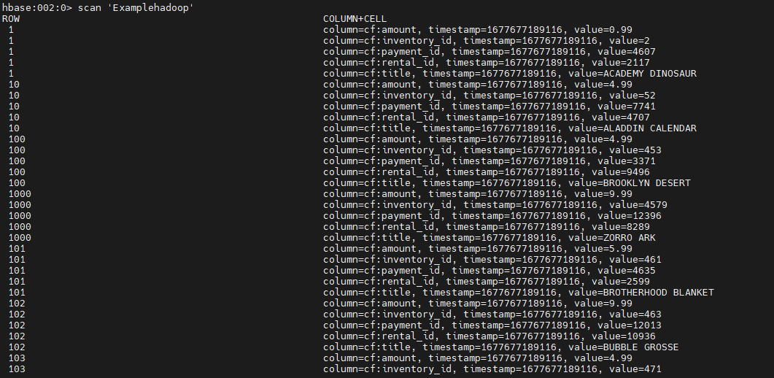
Code snippet and sample output
Film_group_amt output in Hive and Hbase:

Slide 15
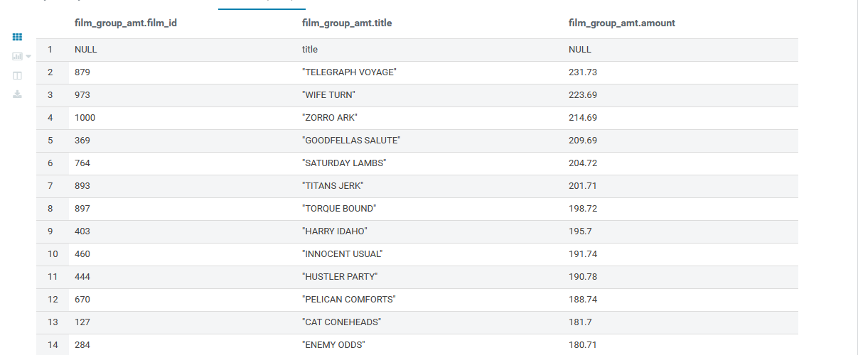
Code snippet and sample output
Film_group_amt output in Hive and Hbase:

Slide 16
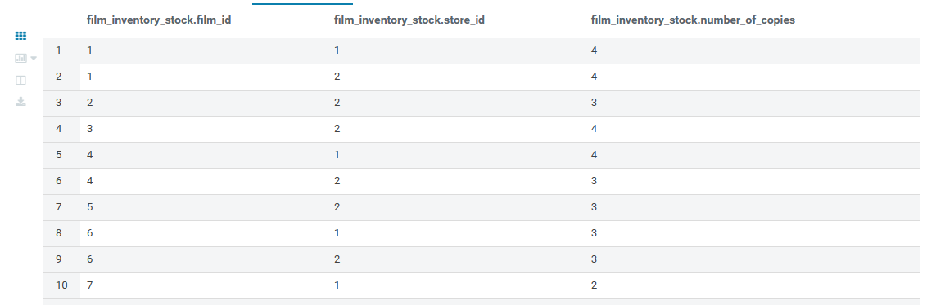
Code snippet and sample output
Film_inventory_stock output in Hive and Hbase:

Slide 17
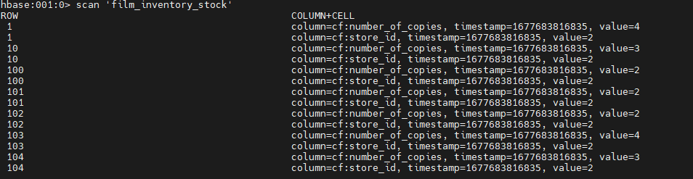
Code snippet and sample output
Film_inventory_stock output in Hive and Hbase:

Slide 18
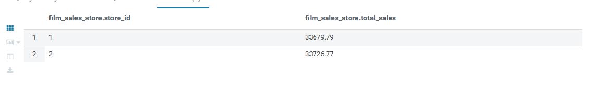
Code snippet and sample output
Film_sales_store output in Hive and Hbase:

Slide 19
Code snippet and sample output
Film_sales_store output in Hive and Hbase:

Slide 20
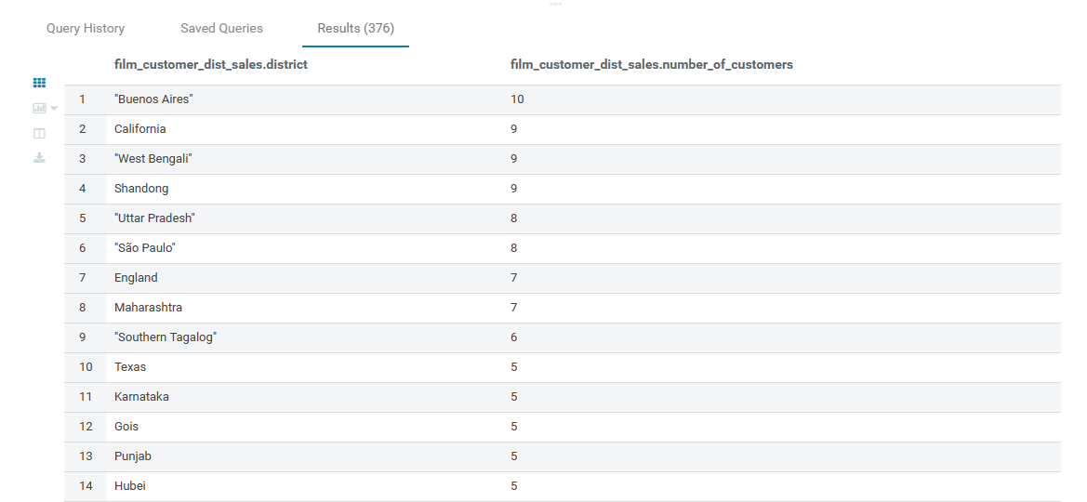
Code snippet and sample output
Film_customer_dist_sales output in Hive and Hbase:

Slide 21
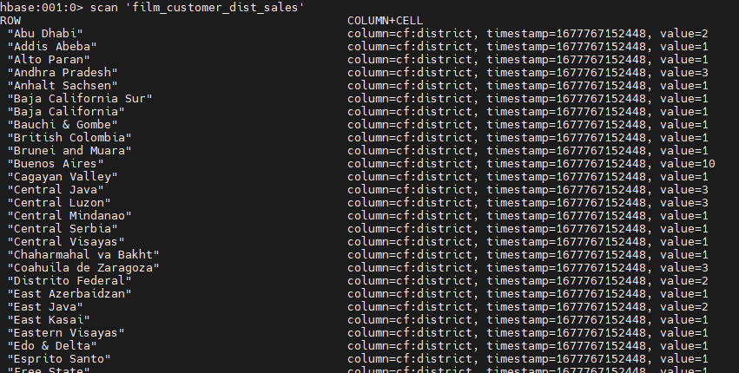
Code snippet and sample output
Film_customer_dist_sales output in Hive and Hbase:

Slide 22
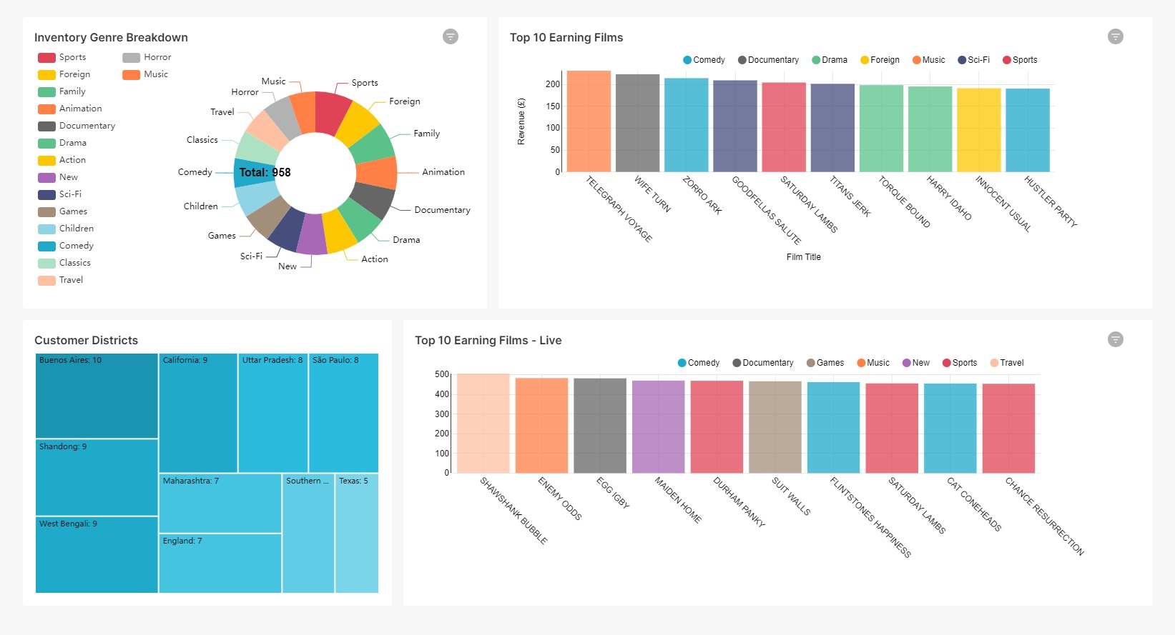
Now we will head over to Superset to see these Visualisations in more detail

Slide 23
FILE FORMATS
For the batch processing, we used a CSV format due to the familiarity with the type. This would improve the speed at which we could manipulate the data due to our prior knowledge
For the realtime data generated by Mockaroo, we used a JSON format. The format made it easier to quickly view the data for clarity and the methods used to convert into a dataframe were not too heavy processing-wise. UJSON was used to process the particular files needed

Slide 24
CHALLENGES
The cluster was unresponsive at times due to a large amount of work being processed from various groups. This led to unpredictable delays during the testing portion of our project and checking that the code worked as intended
Connecting MySQL to Hive directly created some challenges due to JDBC driver issues on MobaXterm. An alternate method was required to move the database ingest the data
Displaying data from Hbase to Superset produced questions of necessity and difficulty due to some connector issues. More sensible to display information directly from Hive after Scala-Spark processing

Slide 25
FUTURE ENHANCEMENTS
Further research can be conducted to find additional data regarding movie rental stores and enrich our current dataset to provide a wider range of results
More visualisations could be added based on other criteria that may be either relevant, specifically requested or that could potentially enhance our use-case
Another enhancement could be to generate an independent analysis on movie culture (e.g. movie popularity ratings on IMDB) alongside our dataset to capture and compare trends with rental rates

Slide 26
QUESTIONS?

Slide 27
THANKS FOR LISTENING

